Slide 1

5CC512
Communication and Security Protocols
Week 5:
Public Key Cryptography

Slide 2

PUBLIC-KEY ENCRYPTION STRUCTURE
First publicly proposed by Diffie and Hellman in 1976
Based on mathematical functions
Asymmetric, involving the use of two separate keys
Misconceptions:
More secure from cryptanalysis than conventional encryption
General-purpose technique that has made conventional encryption obsolete
Key distribution is trivial when using public-key encryption

Slide 3
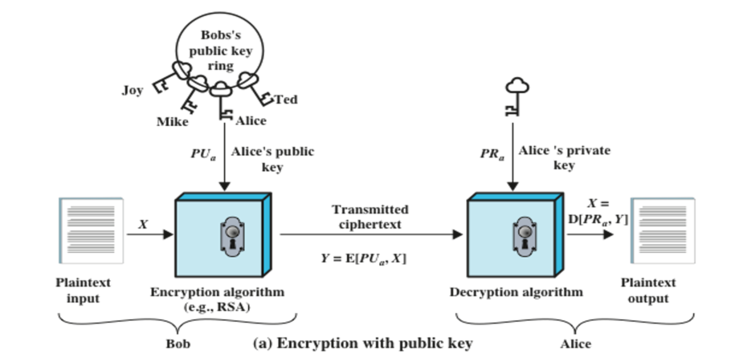
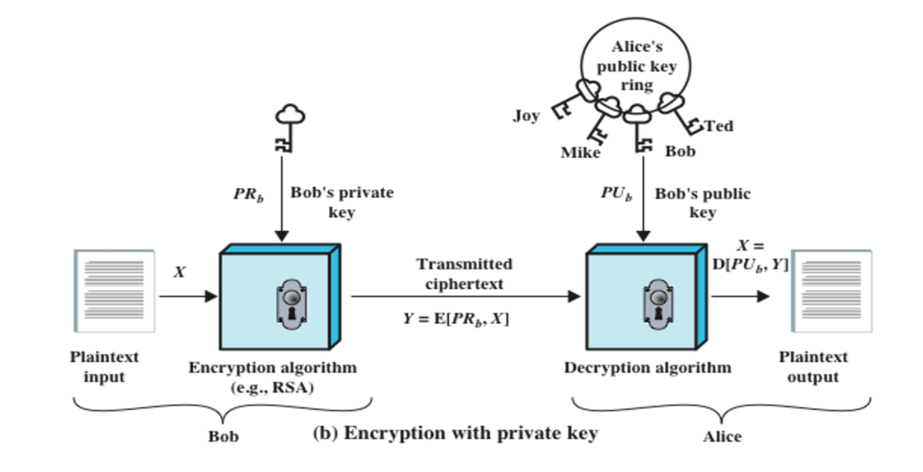
PUBLIC KEY CRYPTOGRAPHY

Slide 4
APPLICATIONS for PUBLIC-KEY CRYPTOSYSTEMS
Characterized by the use of a cryptographic type of algorithm with two keys
  one held private and one available publicly
Sender uses
  the sender’s private key
  the receiver’s public key
  both to perform some type of cryptographic function
The use of public-key cryptosystems can be classified into three categories:
Encryption/decryption
The sender encrypts a message with the recipient’s public key
Digital signature
The sender “signs” a message with its private key
Key exchange
Two sides cooperate to exchange a session key

Slide 5
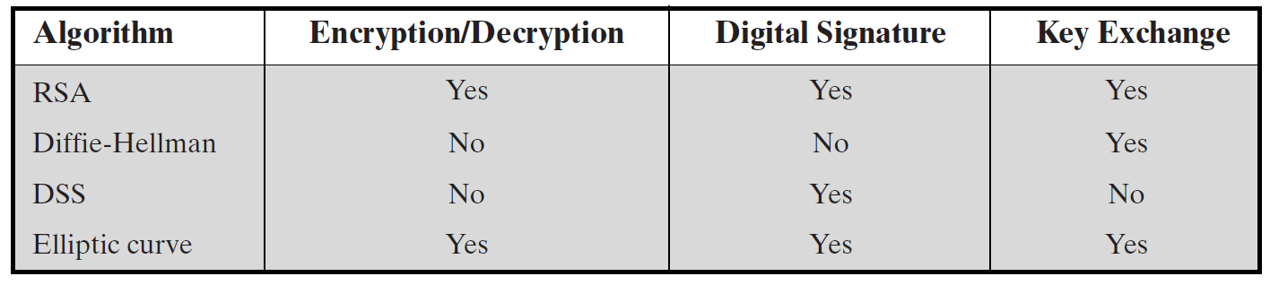
APPLICATIONS for PUBLIC-KEY CRYPTOSYSTEMS

Slide 6
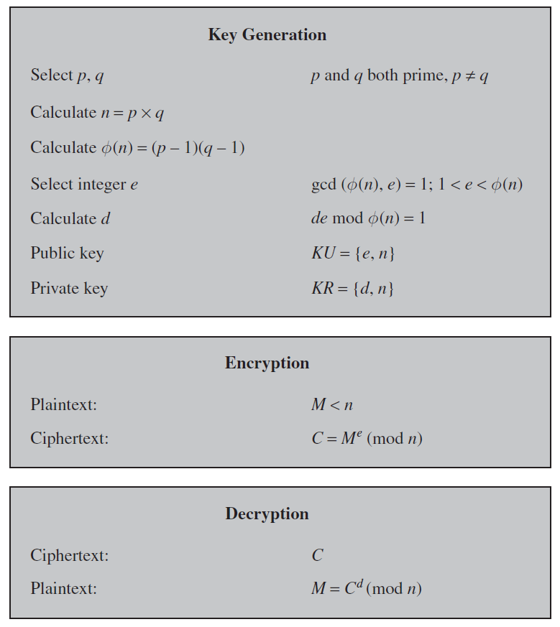
RSA Algorithm
Everybody knows
Keep secret
Goal
  Make guessing d from e and n impractical

Slide 7
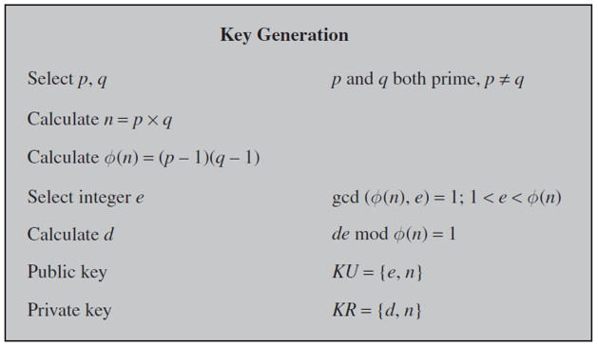

CLASS DISCUSSION
How can we guess d
using e and n ?
How can we make it impractical?
d is calculated using e and $∅(n)$.
$∅(n)$ is calculated using p and q.
p and q may be guessed using n.
Choose very large p and q.
The adversary cannot factorise n into p and q in a practical time period.

Slide 8
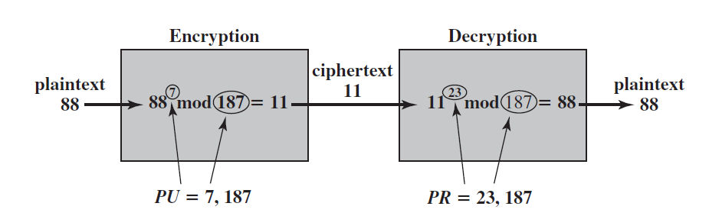
EXAMPLE

Slide 9









CLASS EXERCISE
Consider that the Receiver published the public key, PU = { 3, 33 }.
Calculate the ciphertext for 13
The Receiver’s private key is PK = {7, 33}.
Calculate the plaintext if the ciphertext is 19.
The Adversary tries to break the ciphertext using a random private key, PK={ 5, 33 }
Calculate the plaintext if the ciphertext is 19.
$C= M^{e} (mod n)$
$$= {13}^{3} \left(mod 33 \right)$$
$$=19$$
$M= C^{d} (mod n)$
$$= {19}^{7} \left(mod 33 \right)$$
$$=13$$
$M= C^{d} (mod n)$
$$= {19}^{5} \left(mod 33 \right)$$
$$=10$$

Slide 10
EFFICIENT CALCULATION of C = Me (mod n)
Use big prime numbers for security
  Security depends on the complexity of finding greatest common divisor
Problem : How can a computer calculate plaintext to the power of a big prime number ?
  5674¹⁸⁸⁹⁹ mod 345
Use a property of modular arithmetic
c mod n = ( a x b ) mod n
c mod n = [ (a mod n) x (b mod n) ] mod n

Slide 11
EFFICIENT CALCULATION of C = Me (mod n)
Iterative Calculation : C = Me (mod n)
1 : Set C = 1 , e’ = 0
2: Increase e’ by 1 : e’ = e’ + 1
3: Update C : C = M x C (mod n)
4: if e’ < e then go to Step 2
else stop, C contains the correct solution

Slide 12
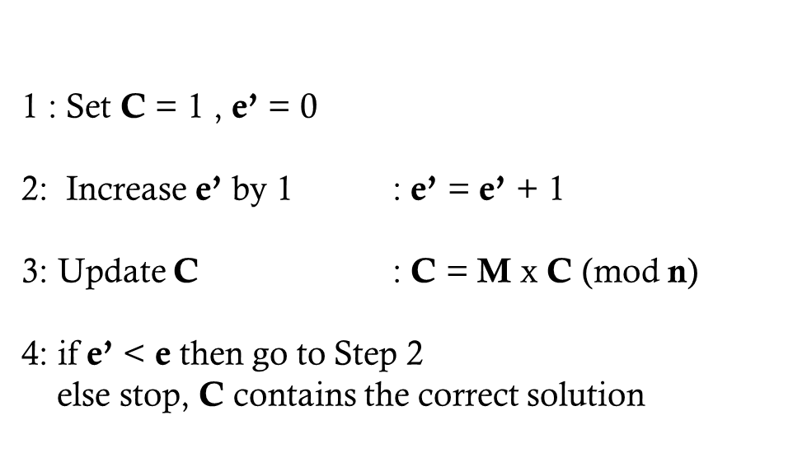

EXAMPLE
PU = {3,33} Plaintext = 13
C = Me (mod n)→ M = 13, e =3, n =33
C e’
Set to 1 0
e’=e’+1 1
Update C 13
$$C=13 × 1 \left(mod 33\right)=13 \left(mod 33\right)=13$$
e’=e’+1 2
Update C 4
$$C=13 × 13 \left(mod 33\right)=169 \left(mod 33\right)=4$$
e’=e’+1 3
Update C 19
$$C=13 ×4 \left(mod 33\right)=52 \left(mod 33\right)=19$$
e’=e’+1 4

Slide 13







CLASS DISCUSSION
Can you compare symmetric and asymmetric encryption?
AES
AES
RSA
RSA

Slide 14
CLASS DISCUSSION
Symmetric
Asymmetric
Same Key is used in the sender and receiver sides
One key is used in the sender ; different key is used in the receiver.
They are mathematically related.
Sharing the key is a problem.
No need to share a key.
The key must be kept secret.
Private key should be secret. But public key is disseminated freely.
Faster
Slower

Slide 15
DIFFIE-HELLMAN KEY EXCHANGE
First published public-key algorithm in 1976 by Whitfield Diffie and Martin Hellman
Widely used, e.g. in Secure Shell (SSH), TLS, and IPSec
DHKE is a key exchange protocol and not used for encryption
A number of commercial products employ this key exchange technique
Enables two users to exchange a secret key securely
  Used for subsequent encryption of messages
  The algorithm itself is limited to the exchange of the keys
Depends for its effectiveness on the difficulty of computing discrete logarithms

Slide 16
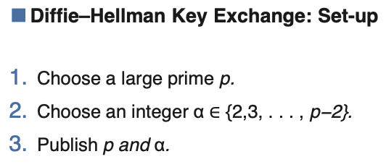

Slide 17
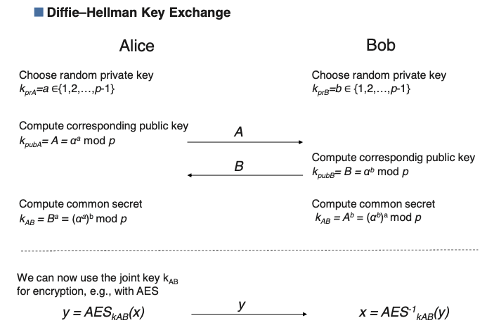

Slide 18
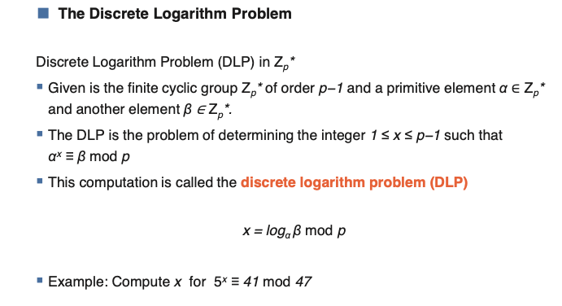

Slide 19
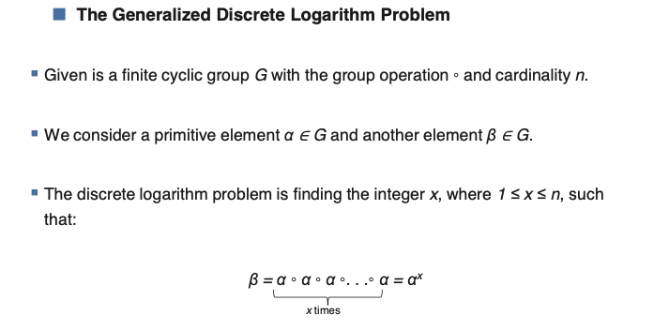

Slide 20

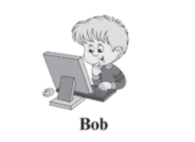






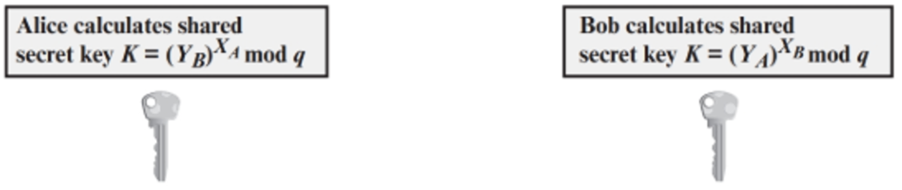
DIFFIE-HELLMAN KEY EXCHANGE
Y_{A}
Y_{B}

Slide 21

CLASS DISCUSSION
Discuss the security of this algorithm.
  Can you identify any vulnerabilities?

Slide 22
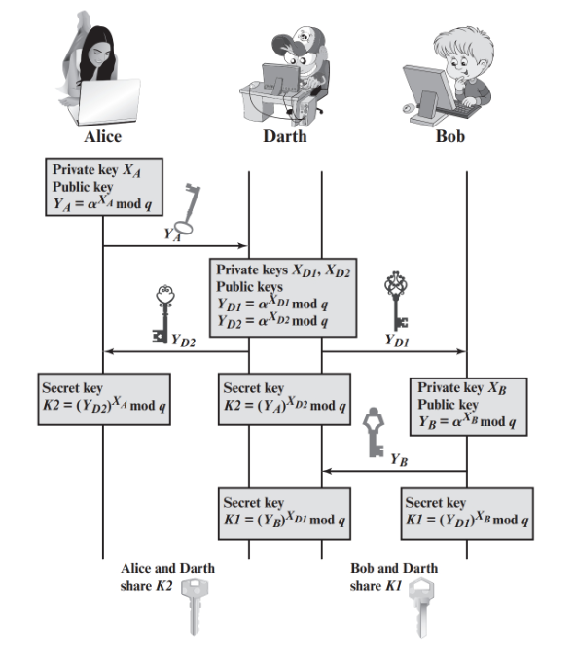
CLASS DISCUSSION

Slide 23
CLASS DISCUSSION
Why is this key exchange protocol vulnerable to Man-in-the-Middle attack?

Slide 24

DIGITAL SIGNATURE STANDARD (DSS)
NIST FIPS PUB 186
Makes use of the SHA-1 and presents a new digital signature technique, the Digital Signature Algorithm (DSA)
Originally proposed in 1991 and revised in 1993 and again in 1996
Uses an algorithm that is designed to provide only the digital signature function
Unlike RSA, it cannot be used for encryption or key exchange

Slide 25
DIGITAL SIGNATURES
NIST FIPS PUB 186-4 (Digital Signature Standard (DSS)) defines a digital signature as:
  “the result of a cryptographic transformation of data that, when properly implemented, provides a mechanism for verifying origin authentication, data integrity, and signatory non-repudiation”
Digital signature
  A data-dependent bit pattern
  generated by an agent as a function of a file, message, or other form of data block
Three digital signature algorithms:
  Digital signature algorithm (DSA)
  RSA digital signature algorithm
  Elliptic curve digital signature algorithm (ECDSA)

Slide 26
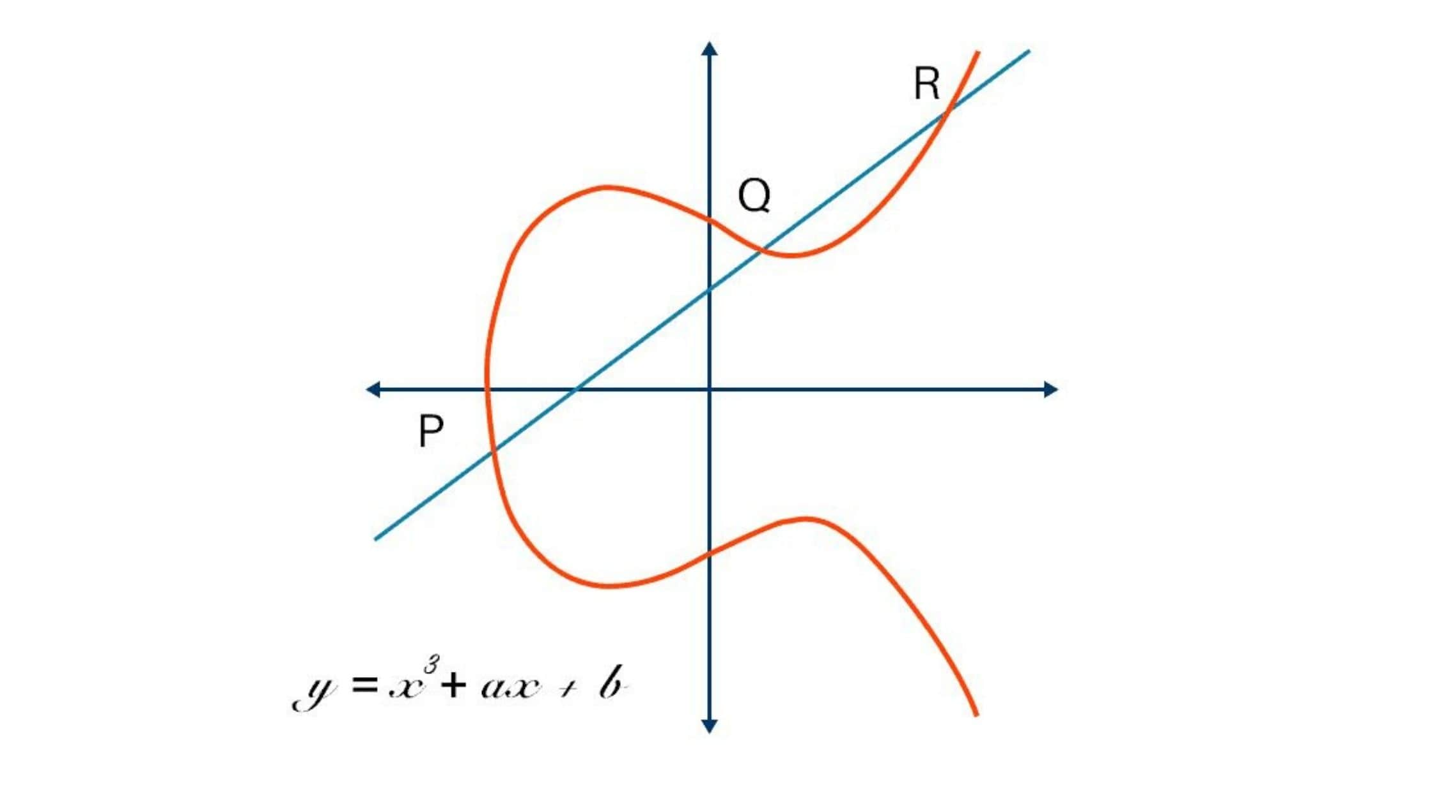
ELLIPTIC-CURVE CRYPTOGRAPHY (ECC)
Based on the use of a mathematical
construct known as the elliptic curve
Principal attraction of ECC compared to RSA
  It appears to offer equal security for a far smaller bit size
    Reducing processing overhead
The confidence level in ECC is not yet as high as that in RSA

Slide 27
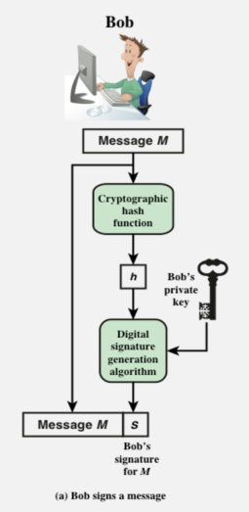
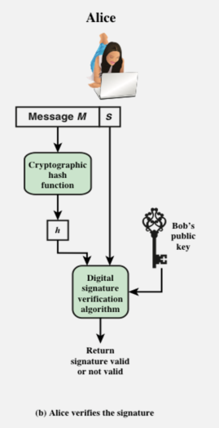
ESSENTIAL ELEMENT OF DIGITAL SIGNATURE PROCESS

Slide 28
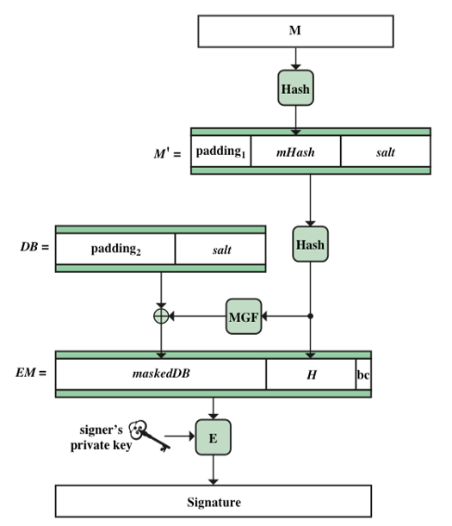
RSA-PSS ENCODING and SIGNATURE GENERATION

Slide 29

Any Questions?

